Slide 1
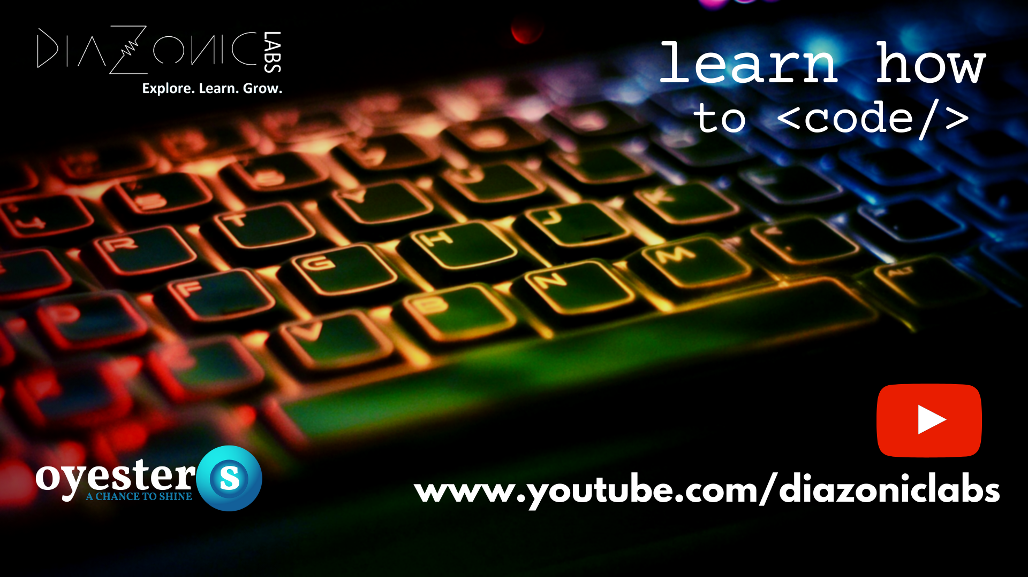
PYTHON 101 – Basics to ML

Slide 2



Write your name and background
in the Q & A window
What are your expectations
for this course?
SHARE YOUR THOUGHTS WITH THE CLASS.

Slide 3

Diazonic Labs
Oyesters Training
Conducts workshops all over India
Collaborated with IIT Bhuvaneshwar
Conducted series of workshops in association with TechFest, IIT Mumbai
Online Technical Forum
Youtube channel
Blogpost
Facebook Group
www.youtube.com/diazoniclabs
www.oyesters.in

Slide 4


IF YOU DON’T COME OUT OF THIS LOCKDOWN WITH:
A NEW SKILL,
MORE KNOWLEDGE,
BETTER HEALTH & FITNESS,
YOU NEVER LACKED TIME.
YOU LACKED DISCIPLINE.
MOTIVATIONAL QUOTE

Slide 5
Flow of the Webinar
Simple Calculator –
Hands on
2. Kahoot Game
3. Demo on ML using
Computer Vision
4. Machine Learning
Course (7 Days)

Slide 6

Outline of topics
- What is Python?
- Features of Python
- Companies using Python
- Applications of Python
- Variables and Datatypes
- Functions
Overview
PYTHON PROGRAMMING – HANDS ON TRAINING

Slide 7


Introduction to Python
Intrepreted High Level Language
Created by Guido Rossum in 1989 as a Hobby project
What is Python?

Slide 8
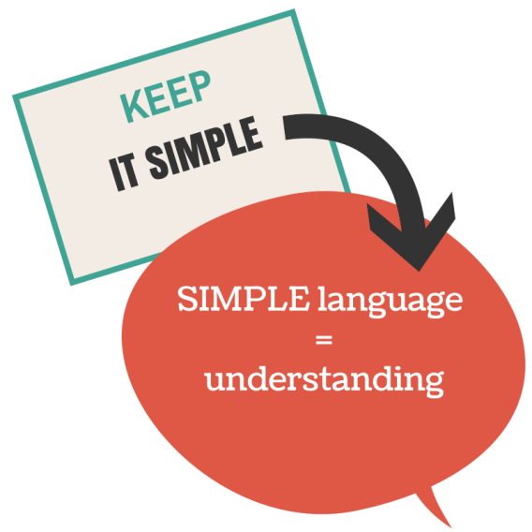
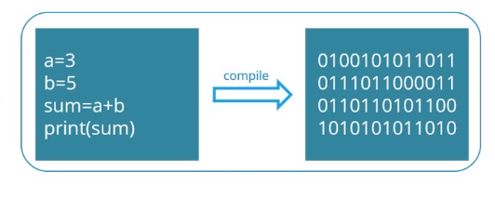
Features of Python
Simple and Easy to understand
Free and Open Source
High- Level Language
Portable and Extensible
Supports multi-styles

Slide 9
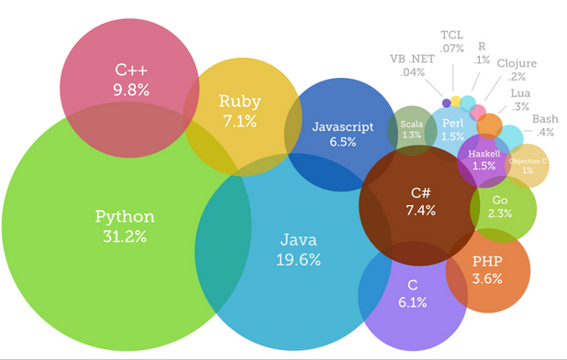

Slide 10
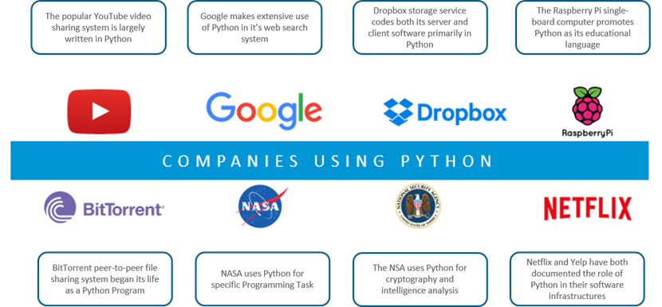

Slide 11



Python IDLE ( Learning)
PyCharm
Jupyter
Spyder
Visual Studio
IDE – Integrated Development Environment
Google Colaboratory

Slide 12
print function
input function
Variables
Datatypes
Conditions
Functions

Slide 13
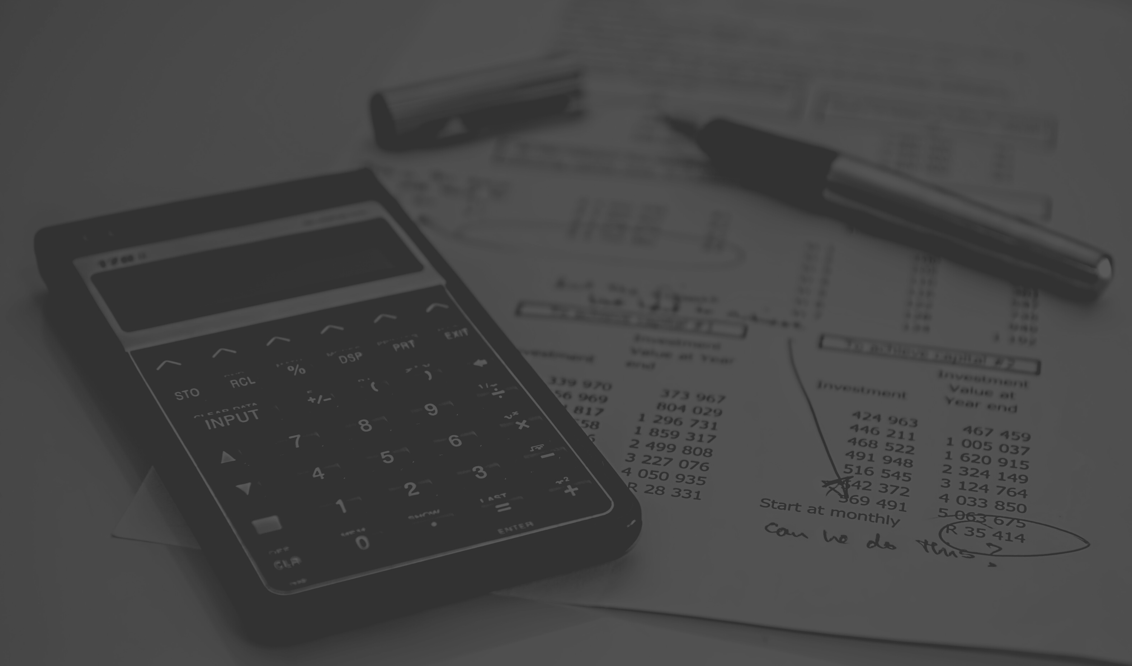
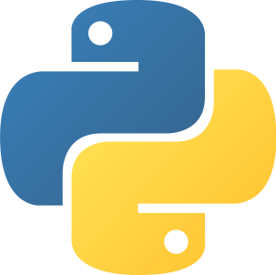
Simple Calculator
in Python
using Google Colab

Slide 14
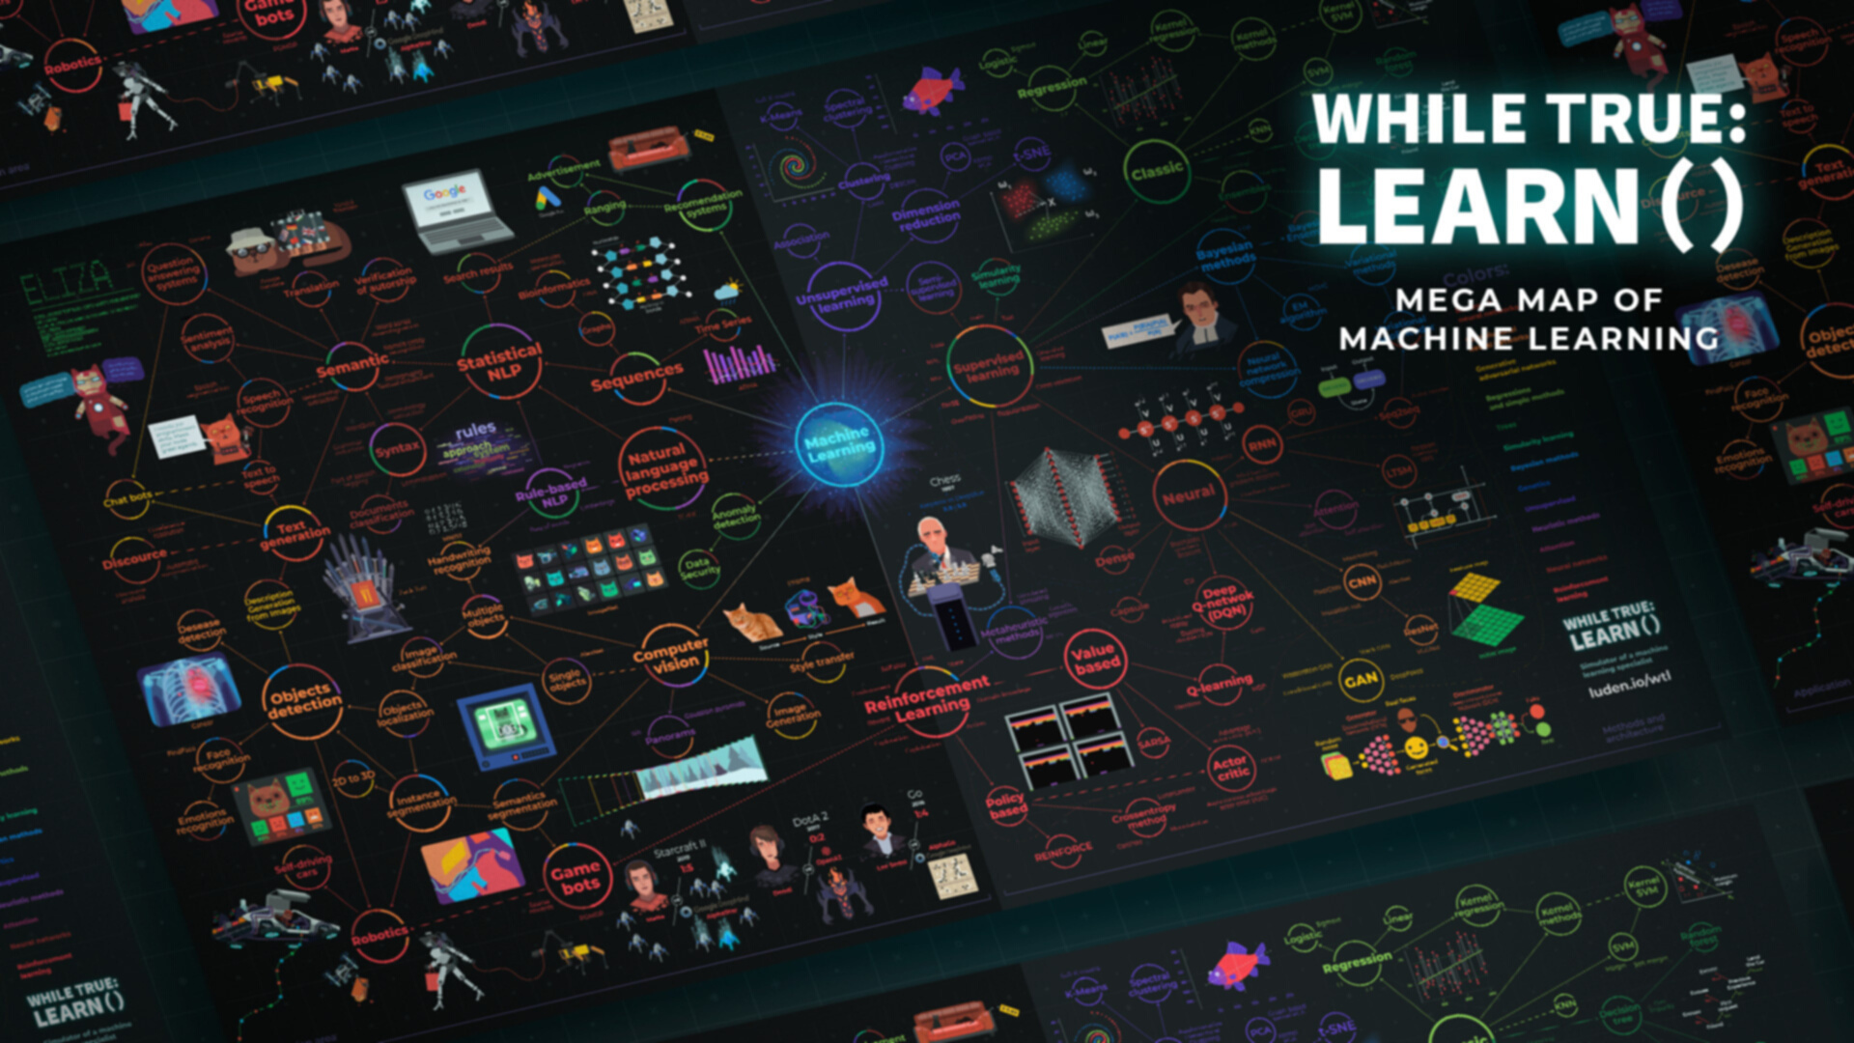
The journey from Basics to Machine Learning
Day 1 - Getting Started with Python 101
Day 2 – Pre – ML ( Numpy , Matplotlib & Pandas Library)
Day 3 – Algorithms in ML using Sklearn
Day 4 – Linear Regression
Day 5 - KNN Algorithm [Classification]
Day 6 - K-Means Algorithm [Clustering]
Day 7 - Capstone Project ( including EDA)
One week
master course

